Slide 1
Usability Testing

Slide 2
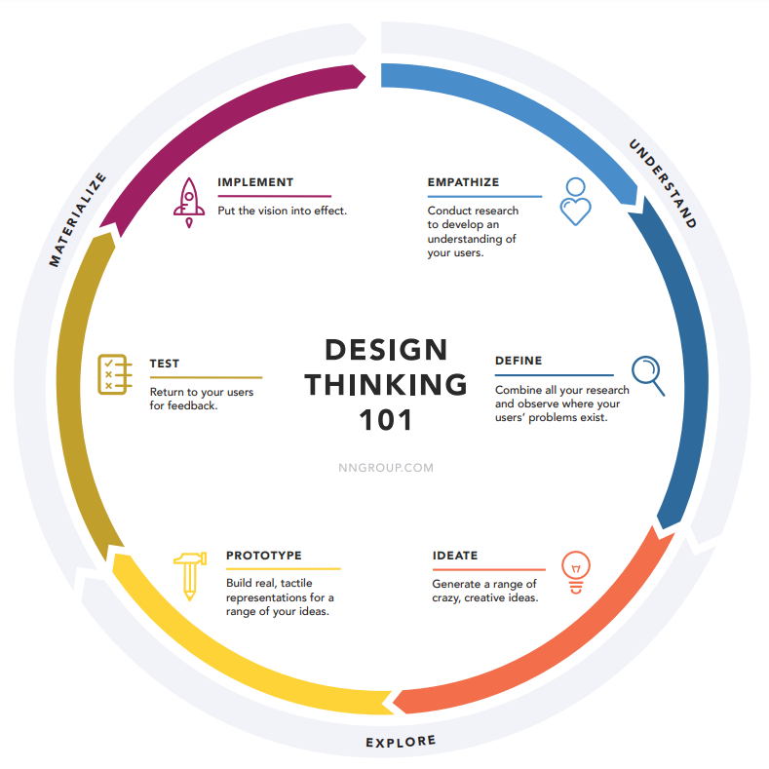
usability testing
https://media.nngroup.com/media/articles/attachments/Design-thinking-101-NNG.pdf

Slide 3
usability testing
https://media.nngroup.com/media/articles/attachments/Design-thinking-101-NNG.pdf

Slide 4
usability testing
Heuristic evaluations
Visibility of system status
Match between system and the real world
User control and freedom
Consistency and standards
Error prevention
Recognition Rather than Recall
Flexibility and efficiency of use
Aesthetic and minimalist design
Help users recognize, diagnose, and recover from errors
Help and documentation
Learnability
Efficiency
Memorability
Absence of Errors
Satisfaction

Slide 5
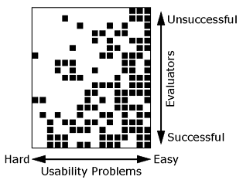
usability testing
Heuristic evaluations
19 evaluators
16 usability problems
Jakob Nielsen

Slide 6
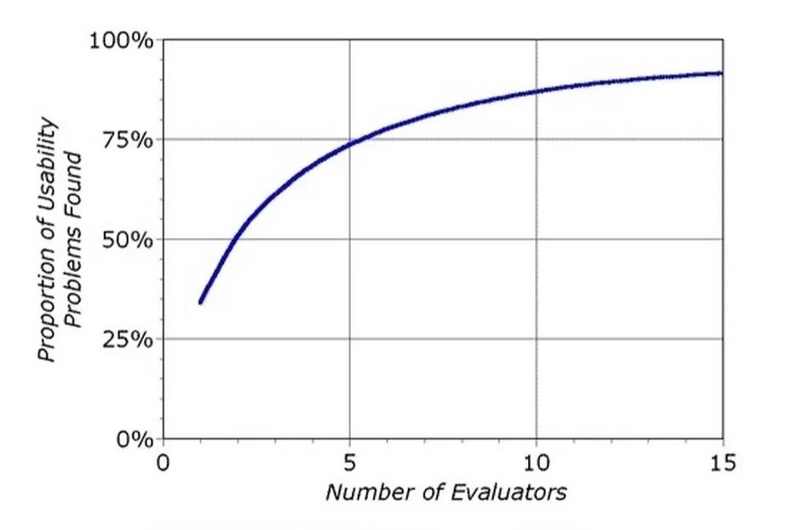
usability testing
Heuristic evaluations
nngroup

Slide 7
prototyping
Usability Tests
Lab
Contextual
Remote Moderated
Remote Unmoderated
Guerrilla Usability Tests

Slide 8
usability testing
🥼Lab Usability Tests🥼
Pros
Accurate & consistent
High-quality
Easy insight into behaviour and mindset
Cons
Hawthorne effect!!!
Artificial surroundings
Expensive af
Time consuming
Low sample size

Slide 9
usability testing
⛷️Contextual Usability Tests⛷️
Pros
Accurate
High-quality
Easy insight into behaviour and mindset
Users are more relaxed
Feedback is realistic
Cons
Expensive
Time consuming af
Uncontrolled variables
Low sample size

Slide 10
usability testing
📝🖥️Remote Moderated Usability Tests🖥️📝
Pros
Cheap
Fast
Large sample size
Users in natural environment
Cons
Lacking behaviour and mindset insights
Not as high-quality as on-site tests
Less opportunity to guide users

Slide 11
usability testing
🖥️Remote Unmoderated Usability Tests🖥️
Pros
Cheap
Fast
Large sample size
Cons
Lacking behaviour and mindset insights
Not as high-quality as on-site tests
Harder to tell if prototype or design flaw

Slide 12
usability testing
🔪Guerrilla Usability Tests🔪
Pros
Quick
Convenient
Fast
Cons
Dirty
Inconsistent data
Superficiel feedback
Possibly false feedback

Slide 13
FIN

